Slide 1
Chapter (3)
The Relational Data Model and Relational Database Constraints
A. Mohammed Khalifa
Karary university

Slide 2
Chapter 3 Outline
1 Relational Model Concepts
2 Relational Model Constraints and Relational Database Schemas
3 Update Operations and Dealing with Constraint Violations

Slide 3
1 Relational Model Concepts

Slide 4
Relational Model Concepts
The relational Model of Data is based on the concept of a Relation
We review the essentials of the formal relational model in this chapter

Slide 5
Relational Model Origins
The model was first proposed by Dr. E.F. Codd of IBM Research in 1970 in the following paper:
  "A Relational Model for Large Shared Data Banks," Communications of the ACM, June 1970
The above paper caused a major revolution in the field of database management

Slide 6
Informal Definitions
Informally, a relation looks like a table of values (see Figure 3.1 on next slide).
A relation contains a set of rows.
The data elements in each row represent certain facts that correspond to a real-world entity or relationship
  In the formal model, rows are called tuples
Each column has a column header that gives an indication of the meaning of the data items in that column
  In the formal model, the column header is called an attribute name (or just attribute)

Slide 7
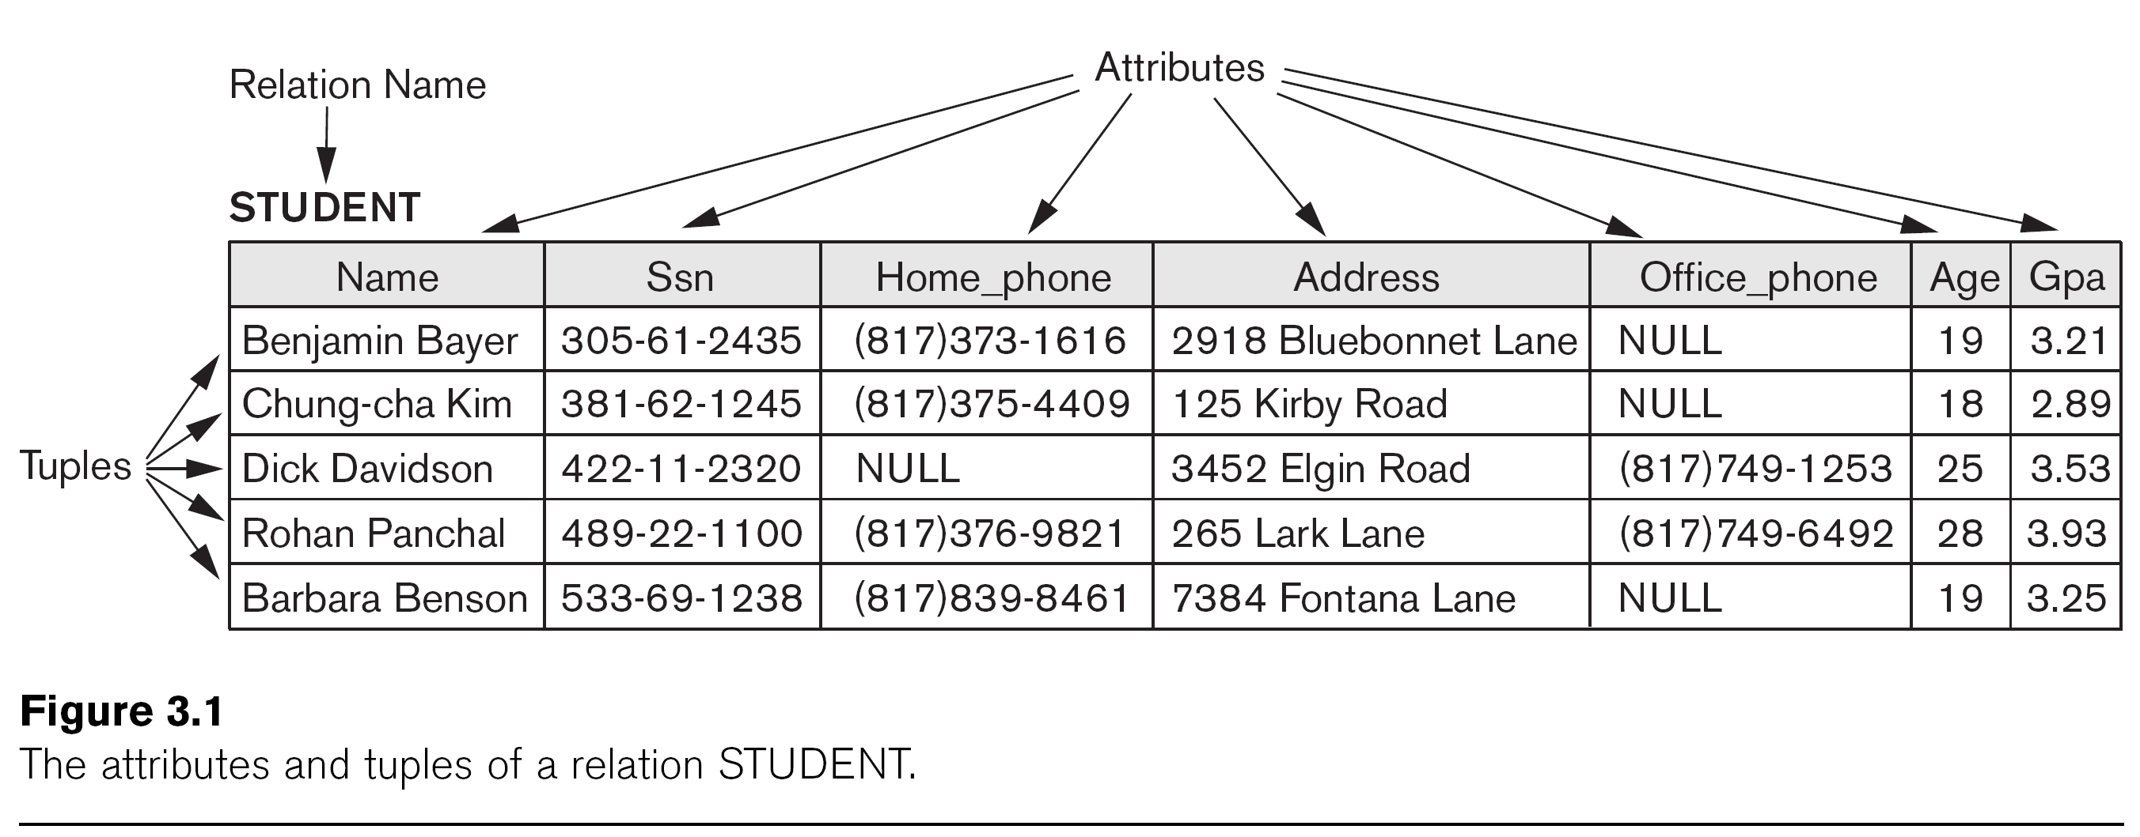
Example of Relation

Slide 8
Informal Definitions
Key of a Relation:
  Each row (tuple) in the table is uniquely identified by the value of a particular attribute (or several attributes together)
    Called the key of the relation
  In the STUDENT relation, SSN is the key

Slide 9
Formal Definitions – Relation Schema
Relation Schema (or description) of a Relation:
  Denoted by R(A1, A2, ..., An) , where :
    R is the name of the relation
    The attributes of the relation are A1, A2, ..., An
    n is the cardinality of the relation
Example:
CUSTOMER (Cust-id, Cust-name, Address, Phone#)
  CUSTOMER is the relation name
  The CUSTOMER relation schema (or just relation) has four attributes: Cust-id, Cust-name, Address, Phone#
Each attribute has a domain or a set of valid values.
  For example, the domain of Cust-id can be 6 digit numbers.

Slide 10
Formal Definitions – Tuple
A tuple is an ordered set of values (enclosed in angled brackets ‘< … >’)
Each value is derived from an appropriate domain.
A row in the CUSTOMER relation is a 4-tuple and would consist of four values, for example:
  <632895, "John Smith", "101 Main St. Atlanta, GA 30332", "(404) 894-2000">
  Called a 4-tuple because it has 4 values
  In general, a particular relation will have n-tuples, where n is the number of attributes for the relation
A relation is a set of such tuples (rows)

Slide 11
Formal Definitions – Domain
A domain of values can have a logical definition:
  Example: “USA_phone_numbers” are the set of 10 digit phone numbers valid in the U.S.
A domain also has a data-type or a format defined for it.
  The USA_phone_numbers may have a format: (ddd)ddd-dddd where each d is a decimal digit.
  Dates have various formats such as year, month, date formatted as yyyy-mm-dd, or as dd:mm:yyyy etc.
The attribute name designates the role played by a domain in a relation:
  Used to interpret the meaning of the data elements corresponding to that attribute
  Example: The domain Date may be used to define two attributes “Invoice-date” and “Payment-date” with different meanings (roles)

Slide 12
Formal Definitions – State of Relation
Formally, a relation state r(R) is a subset of the Cartesian product of the domains of its attributes
  each domain contains the set of all possible values the attribute can take.
  The Cartesian product contains all possible tuples from the attribute domains

Slide 13
Formal Definitions - Summary
Formally (see Figure 3.1),
  Given relation schema R(A1, A2, .........., An)
  Relation state r(R) ⊂ dom(A1) X dom(A2) X ....X dom(An)
R(A1, A2, …, An) is the schema of the relation
R is the name of the relation
A1, A2, …, An are the attributes of the relation
r(R): is a specific state (or "instance" or “population”) of relation R – this is a set of tuples (rows) in the relation at a particular moment in time
  r(R) = {t1, t2, …, tn} where each ti is an n-tuple
  ti = <v1, v2, …, vn> where each vj element-of dom(Aj)

Slide 14
Formal Definitions - Example
Let R(A1, A2) be a relation schema:
  Let dom(A1) = {0,1}
  Let dom(A2) = {a,b,c}
Then: The Cartesian product dom(A1) X dom(A2) contains all possible tuples from these domains:
  {<0,a> , <0,b> , <0,c>, <1,a>, <1,b>, <1,c> }
The relation state r(R) ⊂ dom(A1) X dom(A2)
For example: One possible state r(R) could be {<0,a> , <0,b> , <1,c> }
  This state has three 2-tuples: <0,a> , <0,b> , <1,c>

Slide 15
Relation Definitions Summary
Informal Terms |  | Formal Terms
Table |  | Relation
Column Header |  | Attribute
All possible Column Values or Data Type |  | Domain
Row |  | Tuple
Table Definition |  | Schema of a Relation
Populated Table |  | State of the Relation

Slide 16
Characteristics of Relations
Ordering of tuples in a relation r(R):
  The tuples are not considered to be ordered
Ordering of attributes in a relation schema R (and of values within each tuple):
  We will consider the attributes in R(A1, A2, ..., An) and the values in each t=<v1, v2, ..., vn> to be ordered
  However, a more general definition of relation does not require attribute ordering
  In this case, a tuple t = { <ai, vi>, ..., <aj, vj> } is an unordered set of n <attribute, value> pairs – one pair for each of the relation attributes (see Figure 3.3)

Slide 17
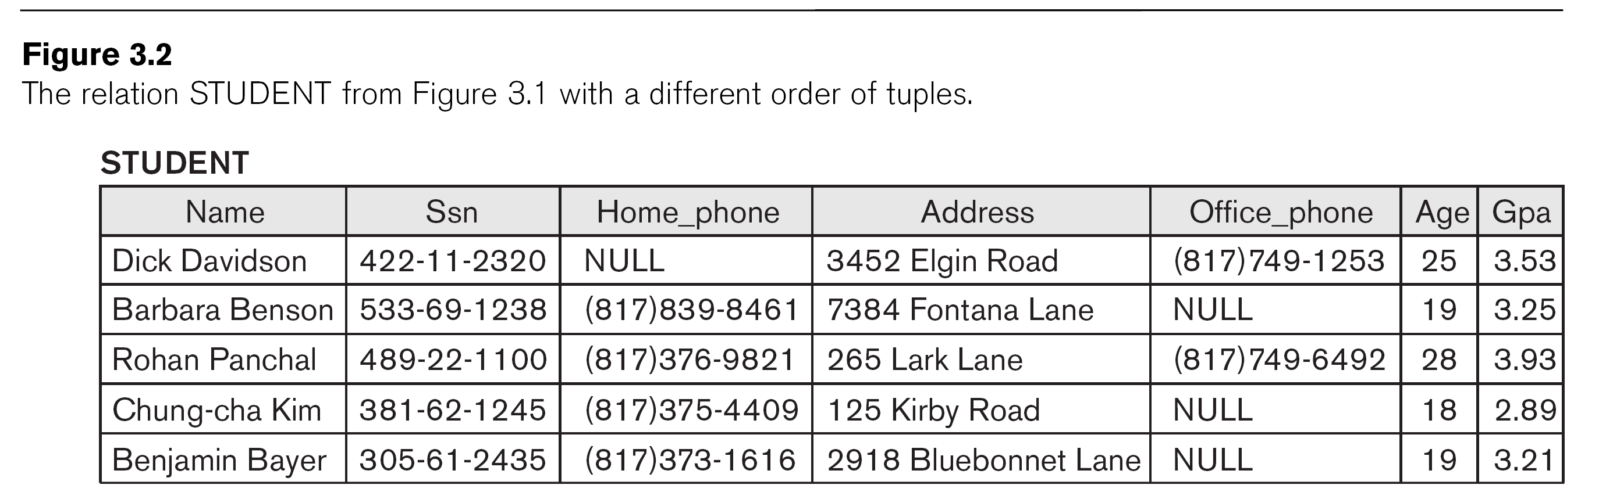

Slide 18
Characteristics of Relations (cont.)
Values in a tuple:
  All values are considered atomic (indivisible).
  Each value must be from the domain of the attribute for that column
    If tuple t = <v1, v2, …, vn> is a tuple (row) in the relation state r of R(A1, A2, …, An)
    Then each vi must be a value from dom(Ai)
  A special null value is used to represent values that are unknown or inapplicable to certain tuples.

Slide 19
Characteristics of Relations (cont.)
Notation:
  We refer to component values of a tuple t by:
    t[Ai] or t.Ai
    This is the value vi of attribute Ai for tuple t
  Similarly, t[Au, Av, ..., Aw] refers to the subtuple of t containing the values of attributes Au, Av, ..., Aw, respectively in t

Slide 20
2 Relational Model Constraints and Relational Database Schemas

Slide 21
Relational Integrity Constraints
Constraints are conditions that must hold on all valid relation states.
Constraints are derived from the mini-world semantics
There are three main types of built-in constraints in the relational model:
  Key constraints
  Entity integrity constraints
  Referential integrity constraints
Another implicit constraint is the domain constraint
  Every value in a tuple must be from the domain of its attribute (or it could be null, if allowed for that attribute)

Slide 22
Key Constraints
Superkey SK of R:
  Is a set of attributes SK of R with the following condition:
    No two tuples in any valid relation state r(R) will have the same value for SK
    That is, for any distinct tuples t1 and t2 in r(R), t1.SK ≠ t2.SK
    This condition must hold in any valid state r(R)
Key K of R:
  Is a "minimal" superkey
  Formally, a key K is a superkey such that removal of any attribute from K results in a set of attributes that is not a superkey (or key) any more (does not possess the superkey uniqueness property)
  Hence, a superkey with one attribute is always a key

Slide 23
Key Constraints (cont.)
Example: Consider the CAR relation schema:
  CAR(State, Reg#, SerialNo, Make, Model, Year)
  CAR has two keys (determined from the mini-world constraints):
    Key1 = {State, Reg#}
    Key2 = {SerialNo}
  Both are also superkeys of CAR
  However, {SerialNo, Make} is a superkey but not a key.
In general:
  Any key is a superkey (but not vice versa)
  Any set of attributes that includes a key is a superkey
  A minimal superkey is also a key

Slide 24
Key Constraints (cont.)
If a relation has several keys, they are called candidate keys; one is chosen to be the primary key; the others are called unique (or secondary) keys
  The primary key attributes are underlined.
Example: Consider the CAR relation schema:
  CAR(State, Reg#, SerialNo, Make, Model, Year)
  We choose License_number (which contains (State, Reg#) together) as the primary key – see Figure 3.4
The primary key value is used to uniquely identify each tuple in a relation
  Provides the tuple identity
  Also used to reference the tuple from other tuples
General rule: Choose the smallest-sized candidate key (in bytes) as primary key
  Not always applicable – choice is sometimes subjective (as in Figure 3.4 – see next slide)

Slide 25
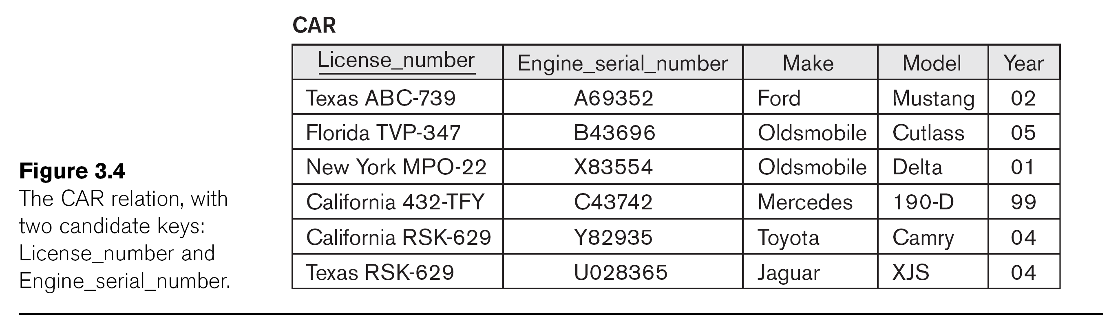

Slide 26
Relational Database Schema
Relational Database Schema:
  A set S of relation schemas that belong to the same database.
  S is the name of the whole database schema
  S = {R1, R2, ..., Rn}
  R1, R2, …, Rn are the names of the individual relation schemas within the database S
Figure 3.5 shows a COMPANY database schema with 6 relation schemas

Slide 28
Relational Database State
Next two slides show an example of a COMPANY database state (Figure 3.6)
  Each relation has a set of tuples
    The tuples in each table satisfy key and other constraints
    If all constraints are satisfied by a database state, it is called a valid state
  The database state changes to another state whenever the tuples in any relation are changed via insertions, deletions, or updates

Slide 29
Continued next page…

Slide 31
Entity Integrity Constraint
Entity Integrity:
  The primary key attributes PK of each relation schema R in S cannot have null values in any tuple of r(R).
    This is because primary key values are used to identify the individual tuples.
    t.PK ≠ null for any tuple t in r(R)
    If PK has several attributes, null is not allowed in any of these attributes
  Note: Other attributes of R may be also be constrained to disallow null values (called NOT NULL constraint), even though they are not members of the primary key.

Slide 32
Referential Integrity Constraint
A constraint involving two relations
  The previous constraints (key, entity integrity) involve a single relation.
Used to specify a relationship among tuples in two relations:
  The referencing relation and the referenced relation.

Slide 33
Referential Integrity (cont.)
Tuples in the referencing relation R1 have attributes FK (called foreign key attributes) that reference the primary key attributes PK of the referenced relation R2.
  A tuple t1 in R1 is said to reference a tuple t2 in R2 if t1.FK = t2.PK
Referential integrity can be displayed as a directed arc from R1.FK to R2.PK – see Figure 3.7

Slide 35
Referential Integrity (or foreign key) Constraint (cont.)
Statement of the constraint
  For a particular database state, the value of the foreign key attribute (or attributes) FK in each tuple of the referencing relation R1 can be either:
    (1) An existing primary key (PK) value of a tuple in the referenced relation R2, or
    (2) a null.
In case (2), the FK in R1 should not be a part of its own primary key, and cannot have the NOT NULL constraint.

Slide 36
Other Types of Constraints
Semantic Integrity Constraints:
  cannot be expressed by the built-in model constraints
  Example: “the max. no. of hours per employee for all projects he or she works on is 56 hrs per week”
A constraint specification language can be used to express these
SQL has TRIGGERS and ASSERTIONS to express some of these constraints (see Section 5.2)

Slide 37
Relational Update Operations
Each relation will have many tuples in its current relation state
The relational database state is a union of all the individual relation states at a particular time
Whenever the database is changed, a new state arises
Basic operations for changing the database:
  INSERT new tuples in a relation
  DELETE existing tuples from a relation
  UPDATE attribute values of existing tuples

Slide 38
3 Update Operations and Dealing with Constraint Violations

Slide 39
Operations to Modify Relations
Three basic operations:
  INSERT
  DELETE
  UPDATE
Integrity constraints should not be violated by the update operations.
Updates may propagate to cause other updates automatically. This may be necessary to maintain integrity constraints.

Slide 40
Update Operations (cont.)
In case of integrity violation, several actions can be taken:
  Cancel the operation that causes the violation (RESTRICT or REJECT option)
  Perform the operation but inform the user of the violation
  Trigger additional updates so the violation is corrected (CASCADE option, SET NULL option)
  Execute a user-specified error-correction routine

Slide 41
INSERT operation
INSERT one or more new tuples into a relation
INSERT may violate any of the constraints:
  Domain constraint:
    if one of the attribute values provided for a new tuple is not of the specified attribute domain
  Key constraint:
    if the value of a key attribute in a new tuple already exists in another tuple in the relation
  Referential integrity:
    if a foreign key value in a new tuple references a primary key value that does not exist in the referenced relation
  Entity integrity:
    if the primary key value is null in a new tuple

Slide 42
DELETE operation
DELETE one or more existing tuples from a relation
DELETE may violate only referential integrity:
  If the primary key value of the tuple being deleted is referenced from other tuples in the database

Slide 43
UPDATE operation
UPDATE modifies the values of attributes in one or more existing tuples in a relation
UPDATE may violate domain constraint and NOT NULL constraint on an attribute being modified
Other constraints may also be violated:
  Updating the primary key (PK):
    Similar to a DELETE followed by an INSERT
    Need to specify similar options to DELETE
  Updating a foreign key (FK) may violate referential integrity
  Updating an ordinary attribute (neither PK nor FK):
    Can only violate domain or NOT NULL constraints

Slide 44
Exercise
(Taken from Exercise 3.16)
Consider the following relations for a database that keeps track of student enrollment in courses and the books adopted for each course:
STUDENT(SSN, Name, Major, Bdate)
COURSE(Course#, Cname, Dept)
ENROLL(SSN, Course#, Quarter, Grade)
BOOK_ADOPTION(Course#, Quarter, Book_ISBN)
TEXT(Book_ISBN, Book_Title, Publisher, Author)
Draw a relational schema diagram specifying the foreign keys for this schema.

